Slide 1
Automating L3VPNs with Ansible
Nitin Vig (nitinvig@juniper.net)
Juniper Networks, APAC

Slide 2
Agenda
Network Automation Landscape
Infrastructure as Code
Demo – L3VPN using Ansible
References

Slide 3
Network Automation Landscape

Slide 4


Network Automation: How do we get there?
Building an evolution path
Day 1
Day 2
Day N
Human-driven automation
Event-driven automation
Machine-driven automation
Establish standard-based network interfaces and data models
Automate network provisioning & management
Simplify network operations
Gather network information (Telemetry)
Use network information to make decisions
Rule-based action on network events
(Closed loop automation)
Use machine-learning tools to train the system
Machines makes decisions and drives network change
Humans make decisions where machines cannot
Notes:
We need to break this problem down into smaller phases. The first phase is Day1 Automation. This is where you should look at getting started. It lays the foundation for the sophisticated Automation that you want to build for your organization.
Day1 Automation lets you ease into the Automation transformation journey. It targets the low-hanging fruits such as communicating with devices using standards-based interfaces, using tools or writing scripts to automate device provisioning, automating daily operation tasks. There is a famous story about how Jeff Besos wrote an internal memo around 2002 mandating all the engineering teams to use only service APIs to communicate with customers and across teams. This change was fundamental in Amazon making the shift from being a ‘book seller’ to world’s largest ‘Cloud infrastructure provider’. Therefore importance of this step cannot be overstated.
This phase is also referred to as Human-driven automation because the Human instructs the machine to perform certain tasks in a programmatic way. Also, in most cases the communication here is one-way or open-loop from the Human to the machine.
The next phase is Day2 or Event-driven automation. Once we have provisioned a device with Day1 automation and it is in service, we want to collect information from this device to understand how it is performing and to fine-tune its performance as required. So we build a closed-feedback-loop between the machine and the human. The device sends data on key metrics using telemetry and we use automation to detect events based on these metrics and take action on these events. While this may seem like a fully automated cycle where there is no role for the Human, the Human actually plays an important role here to build the Rule-based logic that drives this engine. This phase elevates the role of the Human as the brain that ties the events to business logic and builds rules that determine the action to be taken on these events.
The next phase in this evolution is Day N or Machine-driven automation where machines are not just taking actions on the defined rules, they are laso defining the rules. Ofcourse, they do call in the Human when they get stuck and don’t know what to do.
So, this is how the Network Automation will evolve, now lets look at the tools that will make this happen.

Slide 5



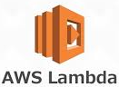




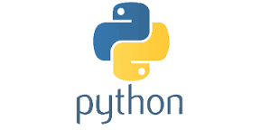







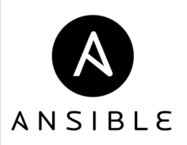
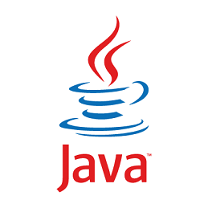
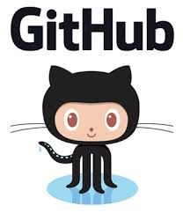

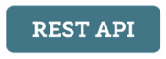






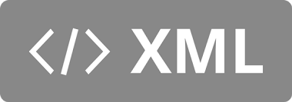
Automation Technologies - Landscape
YANG
Notes:
Automation, DevOps, Machine learning, Artificial intelligence are all somewhere along their journey on the Gartner hype-cycle and as is always the case with any technology on the hype-cycle, there is a soup of tools and buzzwords that surround it. This is another one of those soups that lists some of the important tools that in relation to Automation.

Slide 6
Automation Technologies - Landscape
Day 1
Day 2
Day N
Supervised learning
Unsupervised learning
Reinforcement learning
Deep learning
YANG
Notes:
Let’s try to classify these tools into the phases that we just discussed. Now, if you a familiar with some or all of the tools, you would notice that this classification is not perfect. For example, one could argue that technologies ilke YAML and XML are more foundational and are not specific to any phase or that scripting languages like Python & Ruby have a role to play in Day 1, Human-driven automation. The point of this slide is to provide some high-level guidance on which tools and technologies to focus on during Day1, Day2 or DayN of your Automation journey. Your mileage may vary.

Slide 7
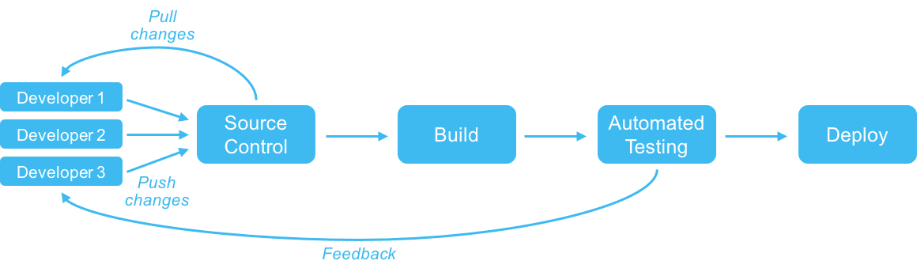
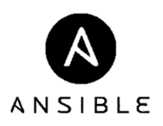

Infrastructure as Code: Adopting software methodology
Continuous Deployment
Continuous Integration
Application 1
Release Management
Or
Application as Code
Application 2
Application 3
Config
Middleware
Configuration Management
Or
Infrastructure as Code
OS
BARE METAL
Application is code, Test is code, Infrastructure is ‘also’ code
Notes:
The software development houses have been following the software lifecycle methodologies for a long-time to consistently churn out quality code. This processe has evolved over time from the traditional Waterfall methodology to an Agile based methodology. Now this Agile methodology is being combined with learnings from the DevOps revolution. The impact of this change has been very positive on the software development industry and its helped to improve the quality and velocity at which code is churned and reduce the risk.
This increased velocity and reduced risk has been made possible by using concepts like Source control, Continuous Integration and Continuous Delivery that help organizations to build a repeatable, self-sustaining software development pipeline.
===Optional (TL;DR)===
The pipeline begins with the build process where the developer commits code to the source control repository. Source control has been around for a while, however the processes around it are changing with the DevOps mentality. The idea is to have a single branch of code (not multiple code branches) that received regular commits in small batches. These changes go through a continual and automated test process and the results of the tests are fed back to the developer. This is the Continuous integration process. Once the build passes testing, it is automatically deployed into production through the Continuous Deployment process.
The developer is responsible for the entire lifecycle from writing code to write tests, to fixing bugs and supporting production.
===/Optional===
What you get at the end of this process is the Application that gets deployed in production. Typically the software development lifecycle ends here. However, this entire lifecycle works on the assumption that the infrastructure required to support the effort is already available for use. This assumption has been a cause of frustration because it is flawed. As we all know, setting up Datacenter infrastructure does not happen overnight and it can sometimes derail the complete delivery schedule. The solution to this problem is Configuration management or ‘Infrastructure as code’. The idea is pretty simple. Treat your infrastructure just like you treat your code. Build a repeatable, self-sustaining pipeline for your infrastructure build up just like you would for your software. Tools such as Puppet, Chef, Ansible and Saltstack help you to automate the entire process of building up your server infrastructure right from the bare metal server to the OS, middleware and their dependencies. This significantly changes how we look at Datacenter infrastructure deployment and takes out a major bottleneck in bringing features to customers faster.
So, now we have the entire stack sorted all the way from the bare metal server to the delivery of the application. But what about the network?

Slide 8
Infrastructure as Code: For the Network
Build
Collaborate and create new configurations
Test
Validate configurations in physical or virtual lab
Demo
Deploy
Deploy new configurations in production
Validate
Validate network behavior after configuration
Monitor
Continuously monitor and provide feedback

Slide 9
Demo

Slide 10


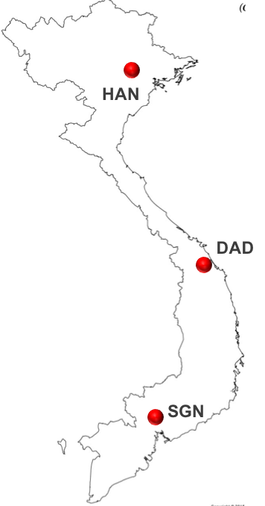

L3VPN Scenario
z
z
3 L3VPN customers across 3 cities:
Toyota: HAN, DAD
Honda: SGN, DAD
Tesla: HAN, SGN
Each customer has 5 branches in each city

Slide 11
L3VPN Scenario
z
z
Objectives:
Automated L3VPN config creation for respective routers
Config deployment to respective routers
Validation of the VPN service on the routers

Slide 12




Demo topology
ANSIBLE
Each city represented by a PE router (vMX)
Brown-field network with basic infrastructure already provisioned (IGP, MP-BGP)
All PE routers have NETCONF-SSH enabled
TOYOTA
TESLA
CORE
HAN
SGN
TESLA
HONDA
DAD
HONDA
TOYOTA

Slide 13
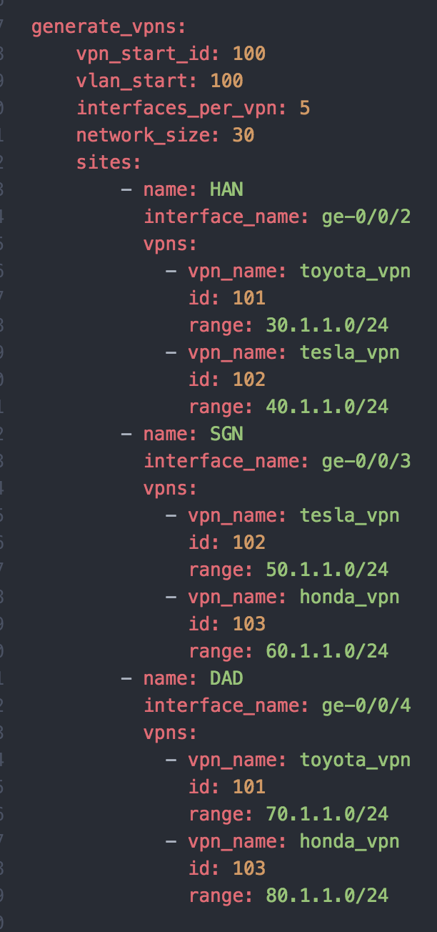
Step 1: User input
Sample User Input (YAML)
Capture user input in a YAML file
File can be generic or be-spoke
Generic files reduce user-input and increase automation
Be-spoke files provide customization
Apply templates to user input to generate variables

Slide 14

Ansible building blocks
Ansible building blocks:
Templates (Jinja)
Variables (YAML)
Playbooks (YAML)
Use templates intelligently to reduce manual effort
Ansible Project
Templates
Variables
Scripts Playbooks
junos-system.j2
bgp.j2
Acl.j2
Interfaces name
Device names
Mgmt IP
IP addresses
Etc ..
deploy_config
check_connectivity

Slide 15
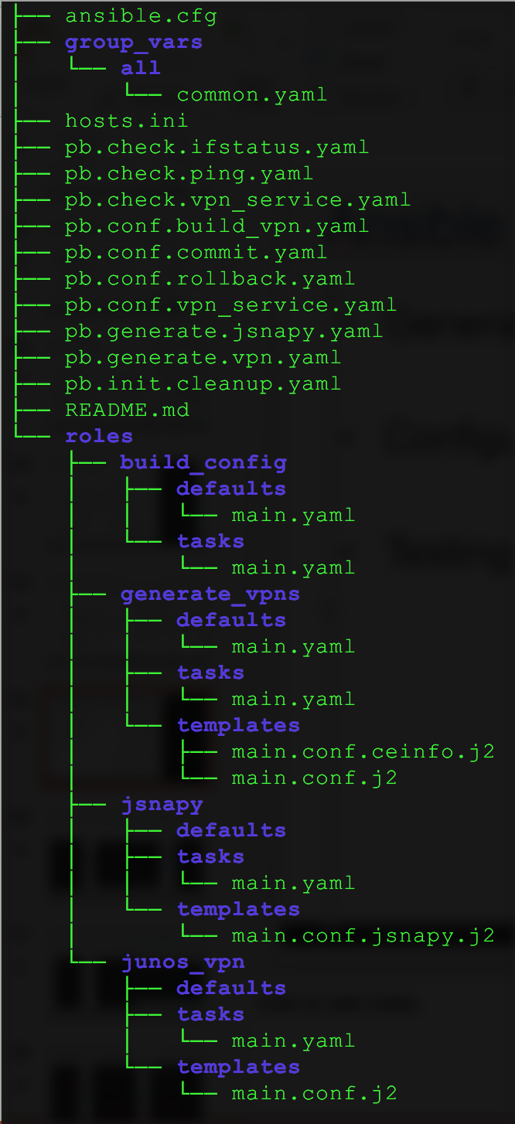
Ansible directory structure (@ start)
Sample User Input (YAML)
Testing PBs
Generate PBs: Generate variables for configuration and testing
pb.generate.vpn.yaml
pb.generate.jsnapy.yaml
Configuration PBs: Generate and push configs
pb.config.vpn_service.yaml
pb.init.cleanup.yaml
pb.config.build_vpn.yaml
pb.config.commit.yaml
Testing PBs: Test the service
pb.check.vpn_service.yaml
pb.check.ifstatus.yaml
pb.check.ping.yaml
Configuration PBs
Generate PBs
Initial PB
Roles

Slide 16
Ansible directory structure (@ start)
Sample User Input (YAML)
Testing PBs
Roles:
generate_vpns
Used by Generate PBs
junos_vpn
Used by Configuration PBs
build_config
Used by Configuration PBs
jsnapy
Used by Testing PBs
Configuration PBs
Generate PBs
Initial PB
Roles

Slide 17
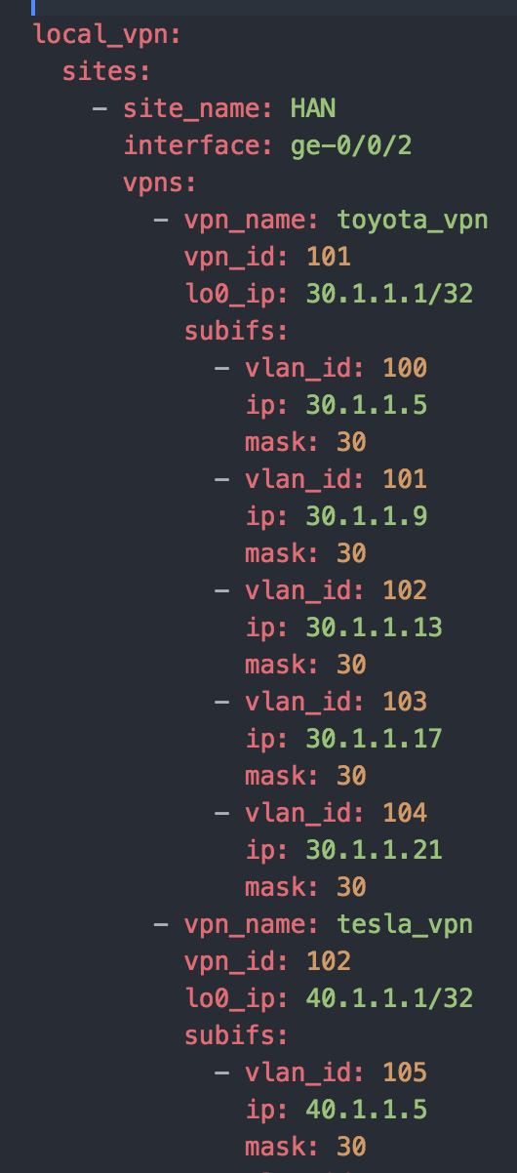
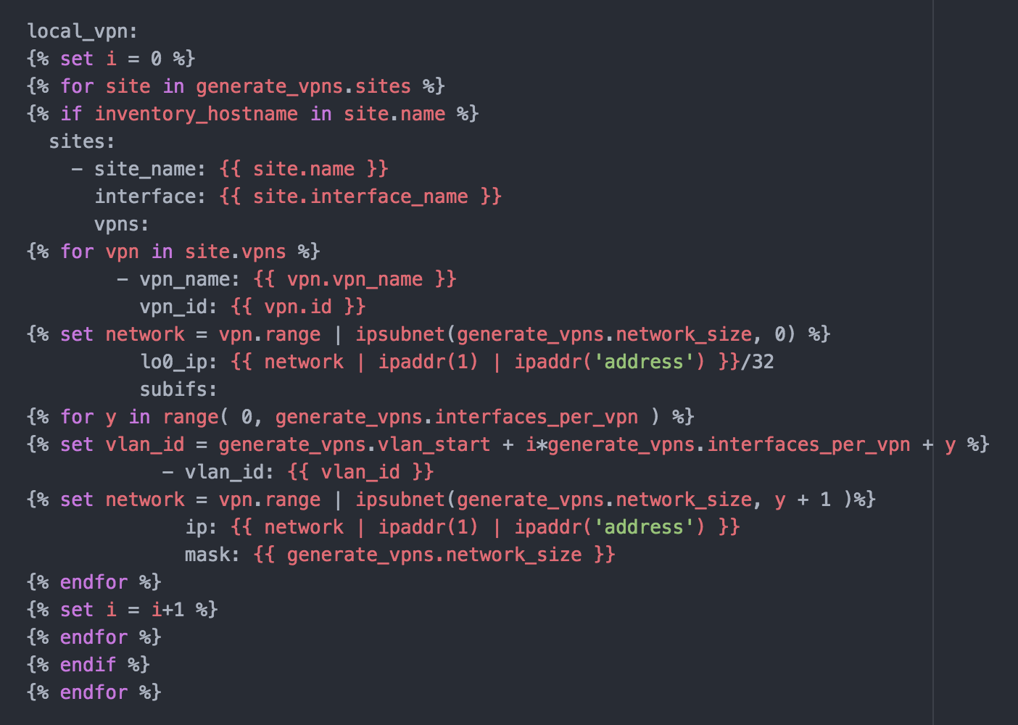
Step 2: Generate variables (Config & testing)
pb.generate.vpn.yaml
roles/generate_vpns/default/main.yaml
+
roles/generate_vpns/templates/main.conf.j2
=
host_vars/HAN/
generated_vpn_variables.yaml
User input (YAML)
Template (Jinja)
Variables (YAML)
a

Slide 18
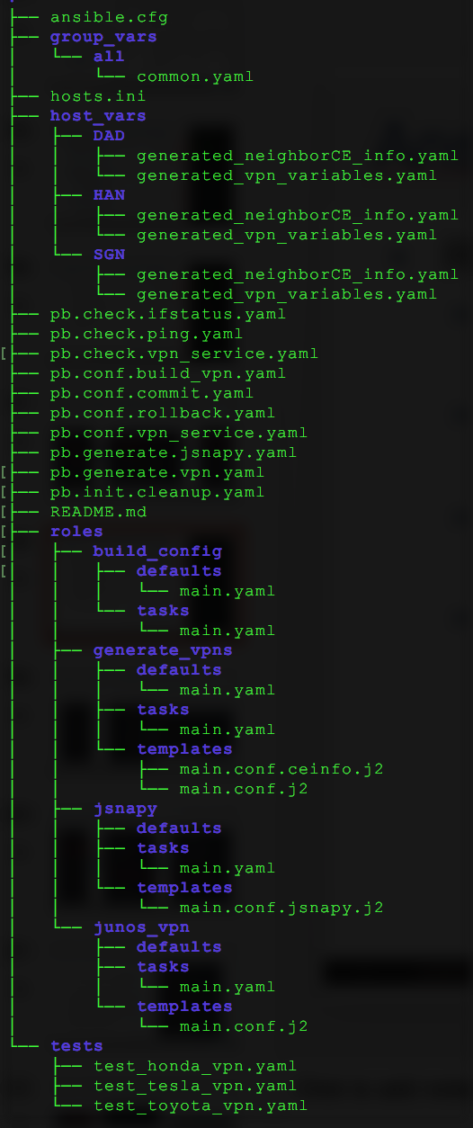
Ansible directory structure (After Step 2)
Sample User Input (YAML)
Host-specific
variables
Host-specific variables:
One directory per host
Each host has 2 YAML files:
generated_vpn_variables.yaml
generated_neighborCE_info.yaml
VPN-specific test YAMLs:
One file per VPN
test_<VPNname>.yaml
VPN-specific
test YAMLs

Slide 19
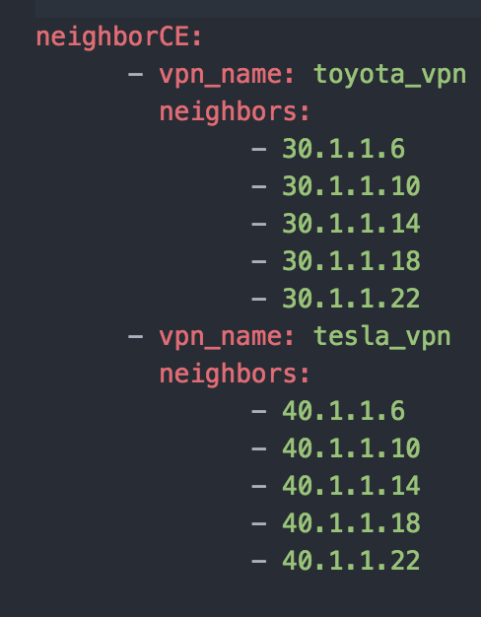
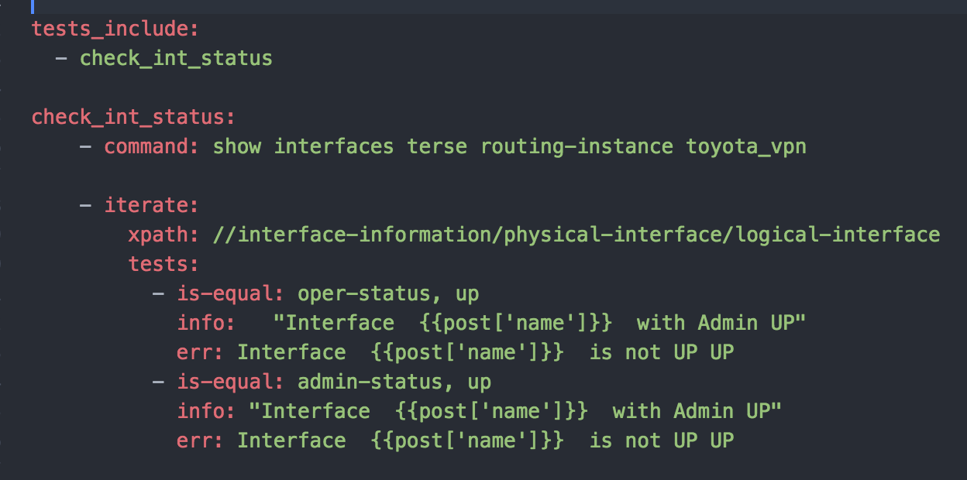
Step 2: Generate variables (Config & testing)
Config Variables
Testing Variables & files
generate_vpn_variables.yaml
generate_neighborCE_info.yaml
test_<VPNname>.yaml

Slide 20
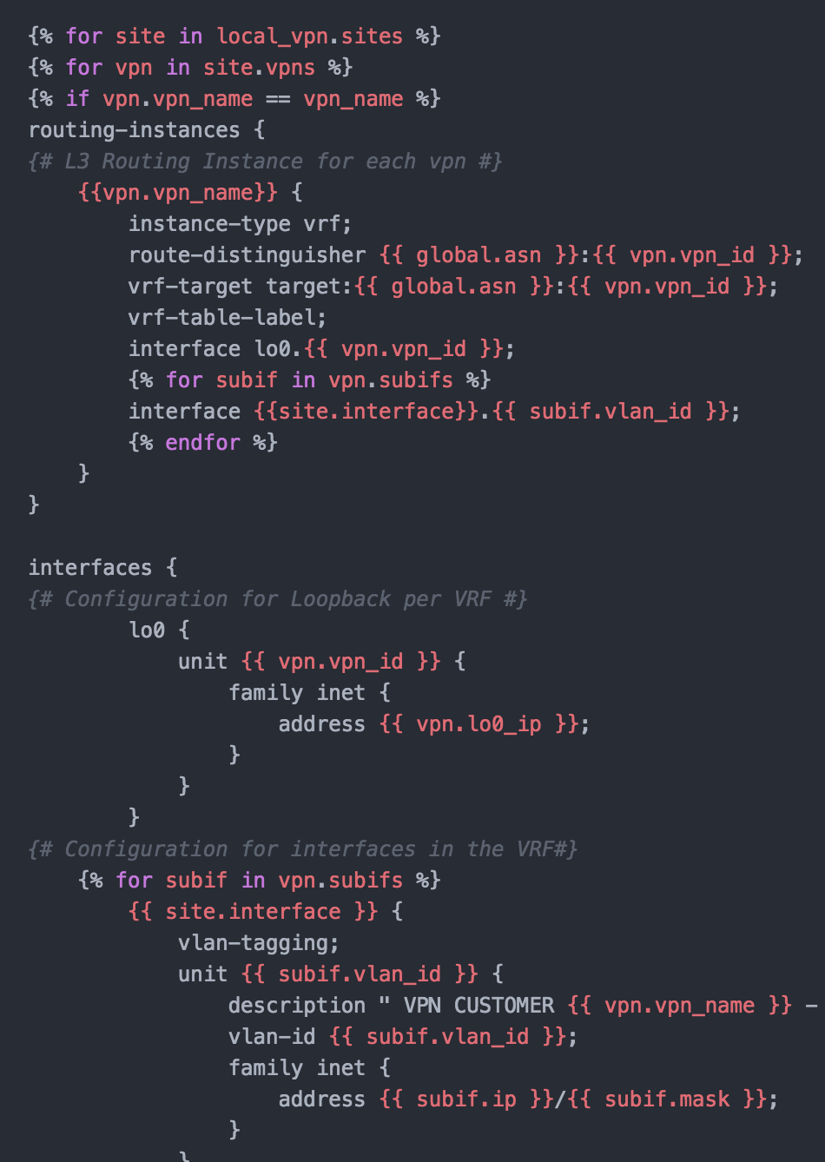
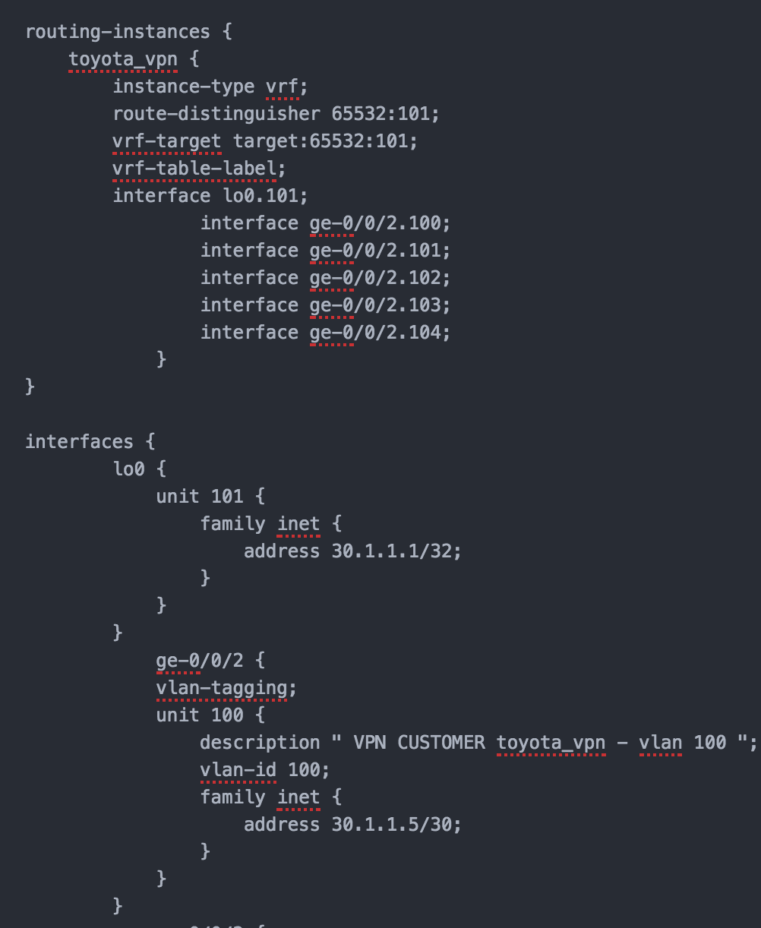
Step 3: Build router config
pb.config.vpn_service.yaml
host_vars/HAN/
generated_vpn_variables.yaml
+
roles/junos_vpn/templates/main.conf.j2
=
config/HAN.conf
Variables (YAML)
Template (Jinja)
Router config
a

Slide 21
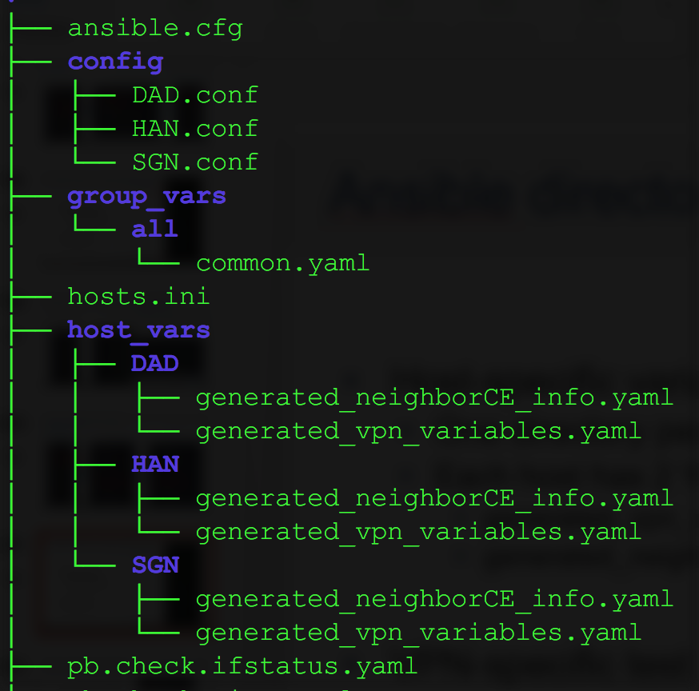
Ansible directory structure (After Step 3)
Sample User Input (YAML)
Host-specific router configs:
One file per host
<Hostname>.conf
Host-specific
Router configs

Slide 22
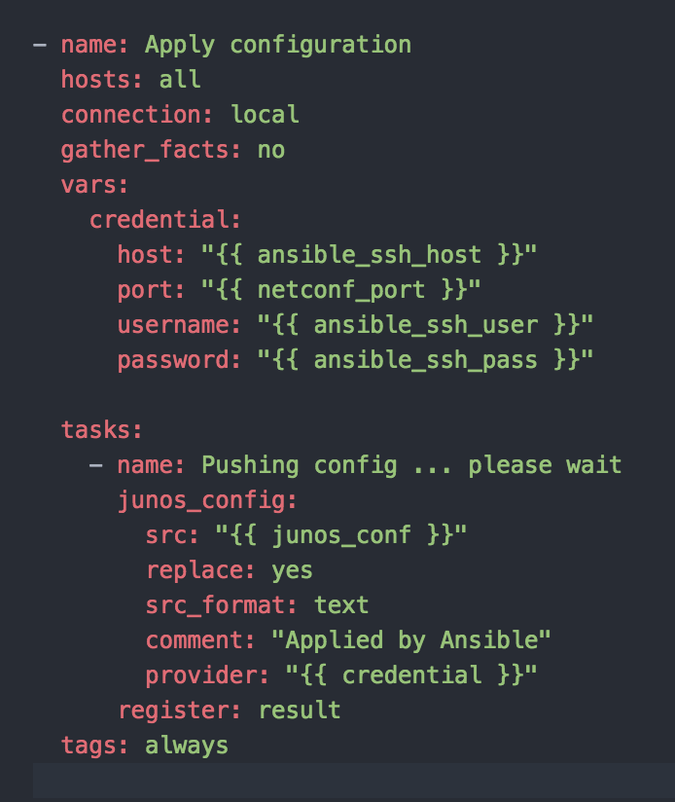
Step 4: Push router config
Connect to each router via NETCONF
Push the respective config to the router
Config can be built and pushed for a single VPN customer also using tags
Config can be rolled back for devices that support this functionality

Slide 23
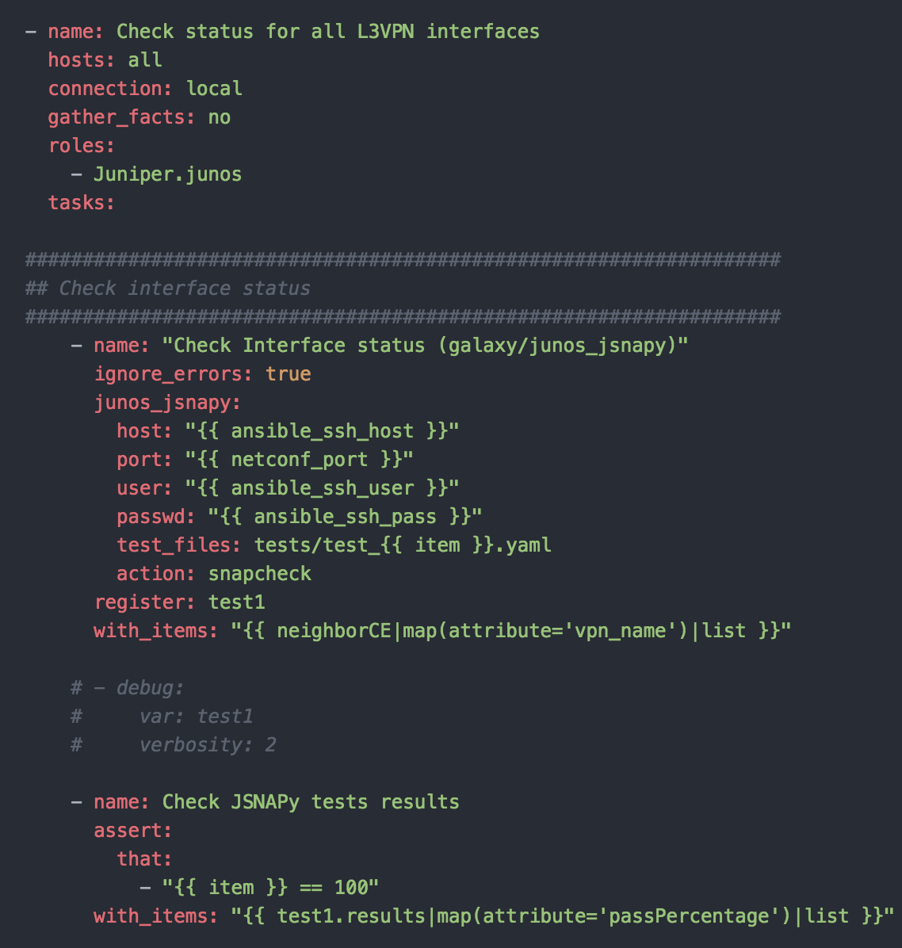
Step 5: Validate VPN service (Interface status)
+
host_vars/HAN/
generated_neighborCE_info.yaml
+
tests/test_toyota_vpn.yaml
pb.check.ifstatus.yaml
Playbook (YAML)
Variables (YAML)
Test file

Slide 24
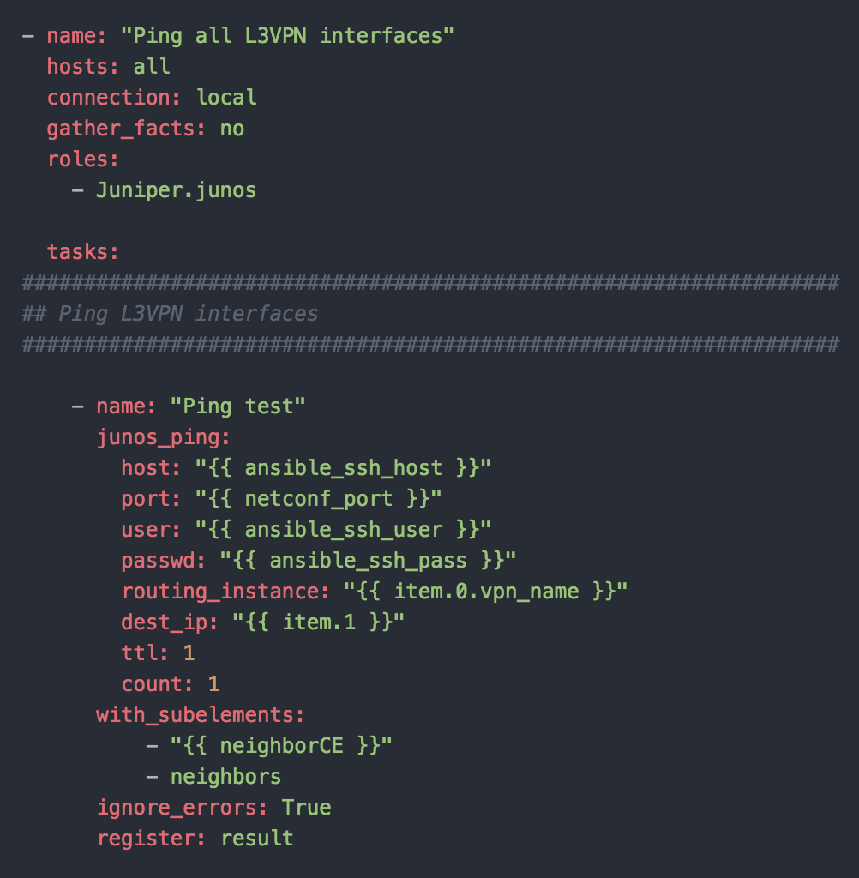
Step 5: Validate VPN service (Ping CE)
pb.check.ping.yaml
+
host_vars/HAN/generated_neighborCE_info.yaml
Playbook (YAML)
Variables (YAML)

Slide 25
References

Slide 26
Demo details
Github repo: https://github.com/vignitin/ansible-junos-l3vpn
Ansible modules used:
Core:
junos_config - Manage configuration on devices running Juniper JUNOS
Galaxy:
Role: Juniper.junos
junos_ping - Execute ping on junos devices
junos_jsnapy – Integrates JSNAPy with Ansible to audit network devices

Slide 27
Interesting Ansible projects
Configure and test and EVPN/VXLAN fabric using Ansible:
https://github.com/JNPRAutomate/ansible-junos-evpn-vxlan
Using Openconfig & Ansible to configure network devices:
https://github.com/ksator/openconfig-demo-with-juniper-devices
JUNOS Automation with Chatops:
https://github.com/ksator/junos-automation-with-chatops

Slide 28
Network telemetry
Open Source Telemetry Collector for Telemetry, Netconf and Events
https://github.com/Juniper/open-nti
Fluentd plugin for Juniper Telemetry Streaming:
https://github.com/JNPRAutomate/fluent-plugin-juniper-telemetry

Slide 29
nitinvig@juniper.net

